Slide 1

STEALTHY MESSAGING [INDUSTRIAL TRAINING PROJECT] Date- 05/12/2022 Programme- B.TECH [CSE]
SUBMITTED TO SUBMITTED BY
MR. ADITYA JAIN
SHIVANG SHARMA
( TCA2011009)
FACULTY OF ENGINEERING
TEERTHANKER MAHAVEER UNIVERSITY, MORADABAD

Slide 2
1- INTRODUCTION
STEALTHY MESSAGING is a project that we have developed in python. In this, sender and receiver can do the hidden communication among themselves means with the help of this project, if sender wants to send a message to a receiver and does not want that message to be seen by any third person, then he can secure his message by using this project.
In this project we use a key by which the message is decrypted and encrypted. If the sender wants to send a message to receiver then he uses that key to convert his simple message into ciphertext which cannot be seen by any third person and at the receiver site if the receiver wants to see that message so he can read that message by decrypting that message with the same key. For making the GUI of the project we are using Tk-inter which is the standard library for Python with the help of which we create GUI of our project.

Slide 3
IMPORTANCE
With the help of tis project we can read the secret message sent by the other so the third person will not understand the message because that message will not be in readable format. STEALTHY MESSAGING helps to protect private information, sensitive data, and can enhance the security of communication between sender and receiver. In essence, when your data is encrypted, even if an unauthorized person or entity gains access to it but they will not be able to read it.
For making the GUI of the project we are using Tk-inter which is the standard library for Python with the help of which we create GUI of our project so with the help of this project we can send such a message to a receiver which cannot be read by any third person.

Slide 4
SYSTEM REQUIRMENTS AND SPECIFICATIONS
Here we are including the software’s and hardware’s used for developing the project and for implementing the project
Software Requirements
Python 3,9
Vs code
3. Any OS
B. Hardware Requirements
1.4 GB RAM or above
2. Intel i3 Processor or above
3. 32 Bit System or above

Slide 5
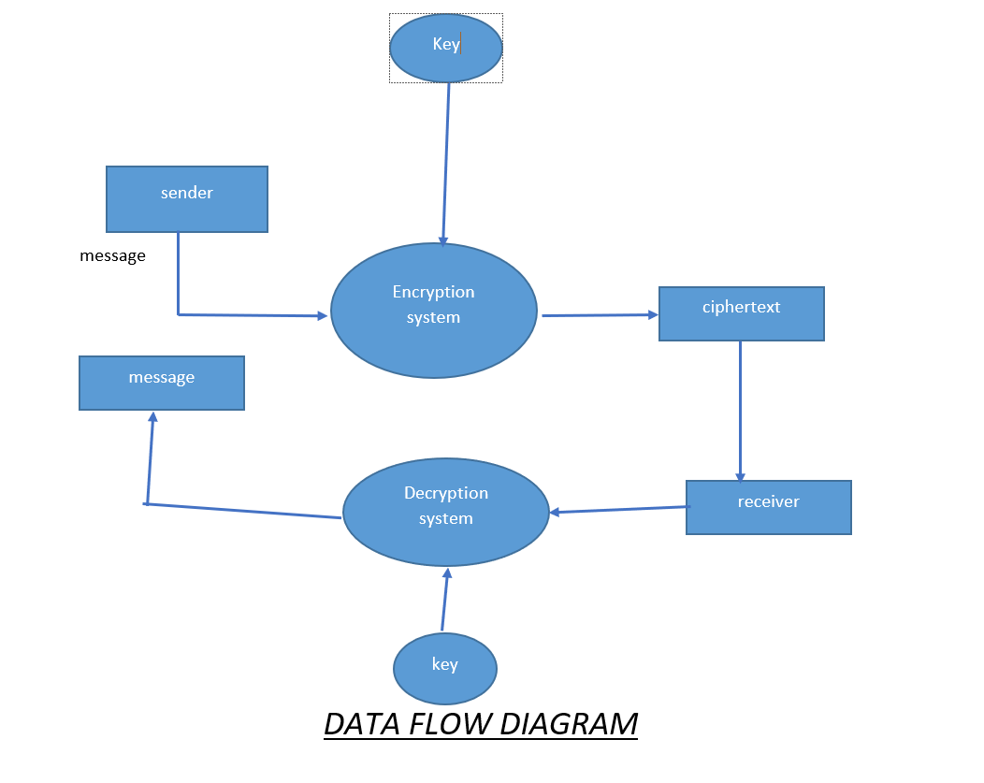

Slide 6
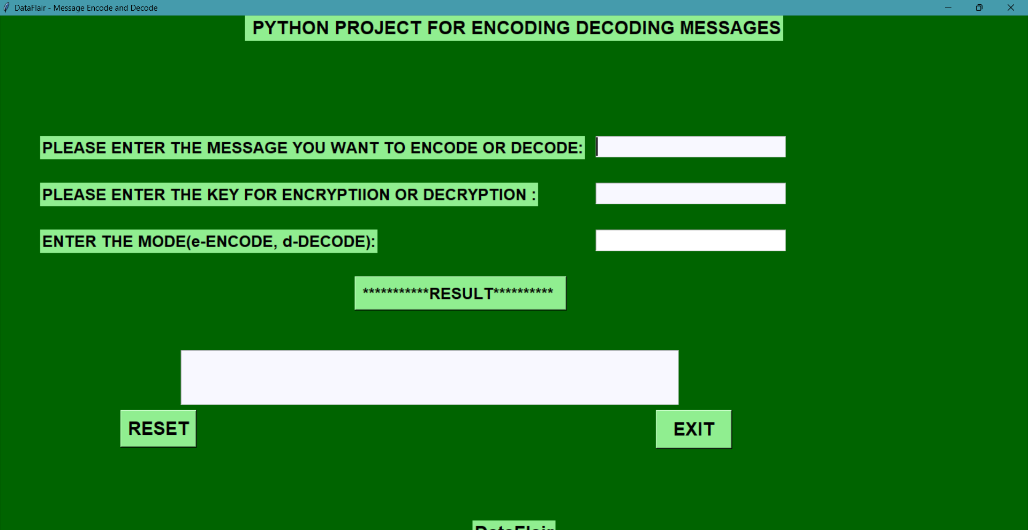

Slide 7
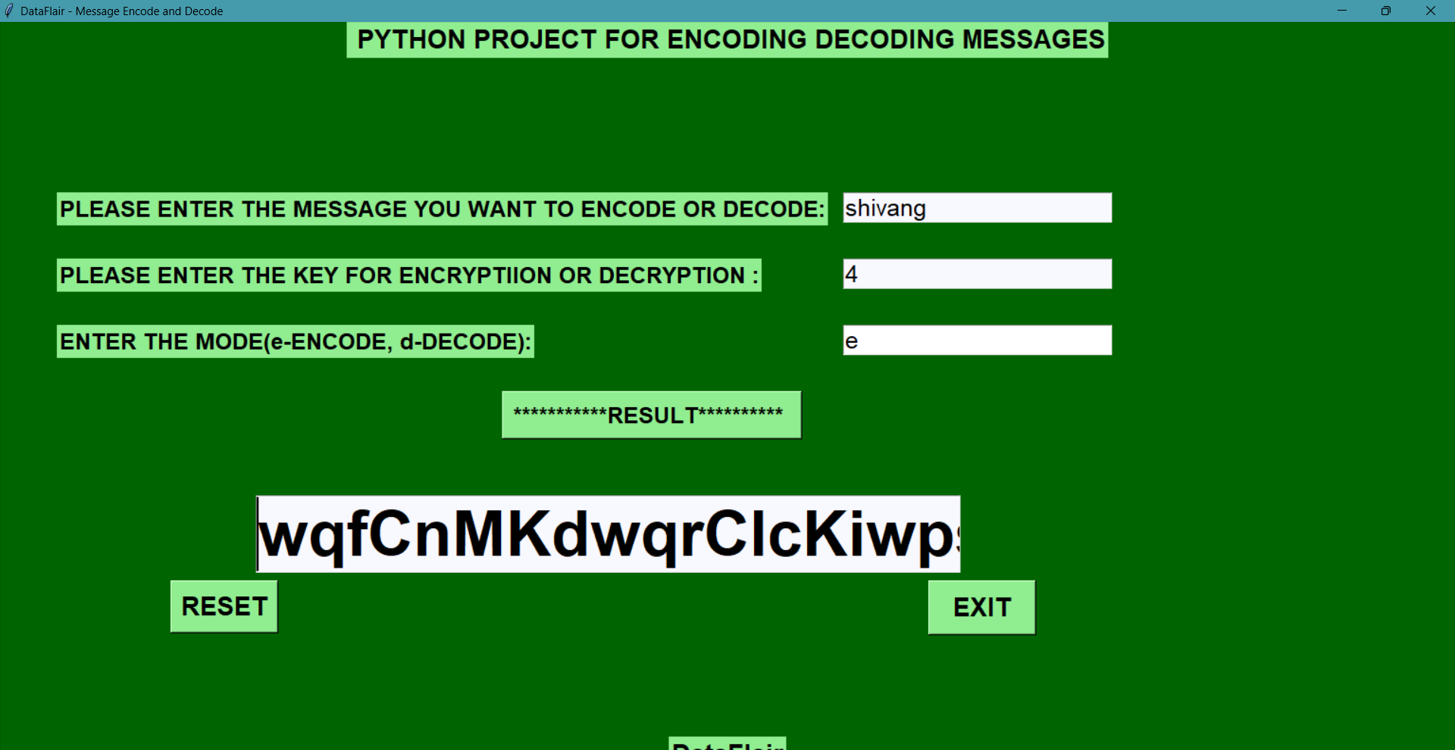

Slide 8
FUTURE WORK
This project is used to convert the readable msg into unreadable format and from unreadable format into readable format because the secure communication is very important nowadays so if a person want to send a secret message to the receiver then he or she can use this project so that they can communicate in a secret language the advantage from using this project is that the third person who is seeing the msg will not understand anything because we are using the key concept here .
In future for the better experience we can add two different keys that is used in cryptography which are public key and private key public key is used on sender side to encrypt the message and private key is used on receiver side to decrypt the message.

Slide 9
CONCLUSION
Cryptography is the study of secure communications techniques that allow only the sender and intended recipient of a message to view its contents. The term is derived from the Greek word crypto, which means hidden. In today’s age of computers cryptography is often associated with the process where an ordinary plain text is converted to cipher text which is the text made such that intended receiver of the text can only decode it and hence this process is known as encryption.
The process of conversion of cipher text to plain text is known as decryption so in this project we are converting the normal message into the hidden msg that is called ciphertext which can not be readable to anyone that only can be decrypted by the receiver when he/ she will use key.

Slide 10
THANK YOU

